Slide 1
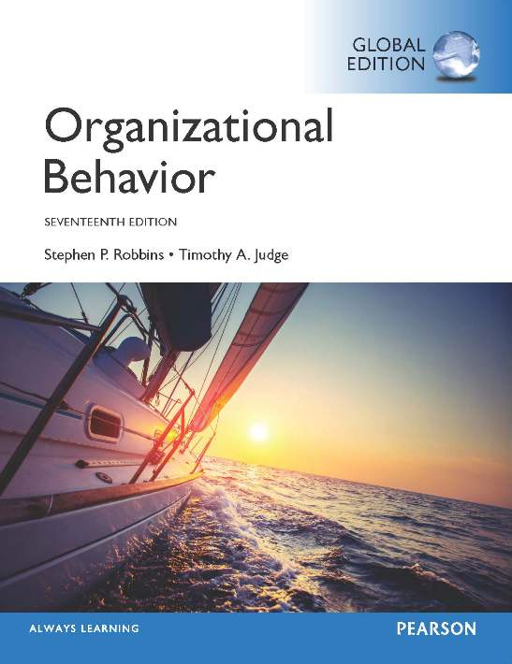
Notes:
Welcome to this Organizational Behavior course that uses the 17th edition of the textbook, Organizational Behavior by Robbins and Judge. This is considered among the most widely used OB textbooks in the world. Robbins and Judge are recognized as definitive aggregators of OB concepts, applications, and practices. The course and this book will provide you with a resource that will benefit you throughout your degree program and your professional life.

Slide 2
11
Communication
Notes:
Chapter 11: Communication

Slide 3
Learning Objectives
Describe the functions and process of communication.
Contrast downward, upward, and lateral communication through small-group networks and the grapevine.
Contrast oral, written, and nonverbal communication.
Describe how channel richness underlies the choice of communication channel.
Differentiate between automatic and controlled processing of persuasive messages.
Identify common barriers to effective communication.
Discuss how to overcome the potential problems of cross-cultural communication.
Notes:
After studying this chapter, you should be able to:
Describe the functions and process of communication.
Contrast downward, upward, and lateral communication through small-group networks and the grapevine.
Contrast oral, written, and nonverbal communication.
Describe how channel richness underlies the choice of communication channel.
Differentiate between automatic and controlled processing of persuasive messages.
Identify common barriers to effective communication.
Discuss how to overcome the potential problems of cross-cultural communication.

Slide 4


Describe the Functions and Process of Communication
LO 1
Communication serves five major functions within a group or organization:
Management
Feedback
Emotional sharing
Persuasion
Information exchange
Notes:
Communication serves five major functions within a group or organization: management, feedback, emotional sharing, persuasion, and information exchange.

Slide 5


Describe the Functions and Process of Communication
LO 1
Communication acts to manage member behavior in several ways.
Authority hierarchies and formal guidelines.
Job descriptions and company policies.
Workgroup teasing or harassing.
Notes:
Communication acts to manage member behavior in several ways.
Organizations have authority hierarchies and formal guidelines employees are required to follow. When employees follow their job descriptions or comply with company policies, communication performs a management function. Informal communication controls behavior too. When workgroups tease or harass a member who produces too much (and makes the rest of the members look bad), they are informally communicating, and managing the member’s behavior.

Slide 6
Describe the Functions and Process of Communication
LO 1
Communication creates feedback by clarifying to employees what they must do, how well they are doing it, and how they can improve their performance.
Formation of goals, feedback on progress, and reward for desired behavior all require communication and stimulate motivation.
Notes:
Communication creates feedback by clarifying to employees what they must do, how well they are doing it, and how they can improve their performance.
Formation of goals, feedback on progress, and reward for desired behavior all require communication and stimulate motivation.

Slide 7

Describe the Functions and Process of Communication
LO 1
Communication within the group is a fundamental mechanism by which members show satisfaction and frustration.
Communication, therefore, provides for the emotional sharing of feelings and fulfillment of social needs.
Notes:
Communication within the group is a fundamental mechanism by which members show satisfaction and frustration. Communication, therefore, provides for the emotional sharing of feelings and fulfillment of social needs. For example, after a white police officer shot an unarmed black man in Ferguson, Missouri in 2015, software engineer Carl Jones wanted to process his feelings through talking with his coworkers at his corporation. As a second example, Starbucks had baristas write “Race Together” on coffee cups to start conversations about race relations. In both cases, the initial communications were awkward—so awkward that Starbucks pulled the campaign—but Jones and others have forged solid relationships from their emotional sharing.

Slide 8
Describe the Functions and Process of Communication
LO 1
Like emotional sharing, persuasion can be good or bad depending on if, say, a leader is trying to persuade a workgroup to believe in the organization’s commitment to corporate social responsibility (CSR) or to, conversely, persuade the workgroup to break the law to meet an organizational goal.
Persuasion can benefit or harm an organization.
Notes:
Like emotional sharing, persuasion can be good or bad depending on if, say, a leader is trying to persuade a workgroup to believe in the organization’s commitment to corporate social responsibility (CSR) or to, conversely, persuade the workgroup to break the law to meet an organizational goal.
It’s important to remember that persuasion can benefit or harm an organization.

Slide 9

Describe the Functions and Process of Communication
LO 1
The final function of communication is information exchange to facilitate decision making.
Communication provides the information individuals and groups need to make decisions by transmitting the data needed to identify and evaluate choices.
Notes:
The final function of communication is information exchange to facilitate decision making. Communication provides the information individuals and groups need to make decisions by transmitting the data needed to identify and evaluate choices.
Almost every communication interaction that takes place in a group or organization performs one or more of these functions, and none of the five is more important than the others. To perform effectively, groups need to maintain some control over members, provide feedback to stimulate members to perform, allow emotional expression, monitor the persuasive efforts of individuals, and encourage information exchange.

Slide 10
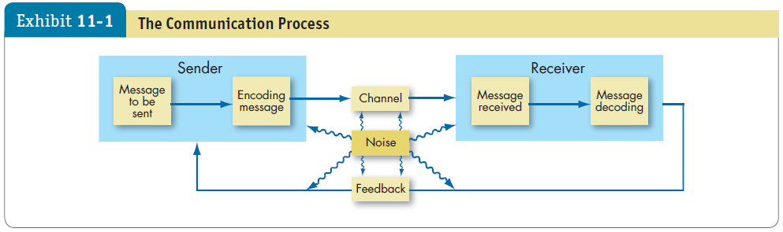


Describe the Functions and Process of Communication
LO 1
Communication Process: The steps between a source and a receiver that result in the transfer and understanding of meaning.
established by the organization and transmit messages related to the professional activities of members
which are spontaneous and emerge as a response to individual choices
Notes:
As shown here in Exhibit 11-1, the communication process is made up of eight parts: the sender, encoding, the message, the channel, decoding, the receiver, noise, and feedback.
The sender initiates a message by encoding a thought. The message is the actual physical product from the source. The channel is the medium through which the message travels. The sender selects it, determining whether to use a formal or informal channel.
Formal channels _ established by the organization and transmit messages related to the professional activities of members. They traditionally follow the authority chain within the organization. Other forms of messages, such as personal or social, follow informal channels, which are spontaneous and emerge as a response to individual choices
The receiver is the person(s) to whom the message is directed, who must first translate the symbols into understandable form. This step is the decoding of the message. Noise represents communication barriers that distort the clarity of the message, such as perceptual problems, information overload, semantic difficulties, or cultural differences. The final link in the communication process is a feedback loop. Feedback is the check on how successful we have been in transferring our messages as originally intended. It determines whether understanding has been achieved.

Slide 11




Contrast Downward, Upward, and Lateral Communication
LO 2
Downward communication: flows from one level to a lower level.
Assign goals, provide instructions, communicate policies and procedures, and provide feedback.
Downward communication must explain the reasons why a decision was made.
One problem is the one-way nature of downward communication.
Notes:
Downward communication occurs when communication flows from one level of a group organization to a lower level. Its purpose is to assign goals, provide instructions, communicate policies and procedures, provide feedback, etc.
When engaging in downward communication, managers must explain the reasons why a decision was made. Explanations increase employee commitment and support of decisions. One problem in downward communication is its one-way nature; generally, managers inform employees but rarely solicit their advice or opinions. The best communicators explain the reasons behind their downward communications but also solicit communication from the employees they supervise.

Slide 12

Contrast Downward, Upward, and Lateral Communication
LO 2
Upward communication: flows to a higher level in the group or organization.
Provide feedback to higher-ups, inform them of progress, and relay current problems.
Communicate in headlines, not paragraphs.
Support your headlines with actionable items.
Prepare an agenda to make sure you use your boss’s attention well.
Notes:
Upward communication flows to a higher level in the group or organization. It is used to provide feedback to higher-ups, inform them of progress, and relay current problems.
Managers rely on upward communication for ideas on how conditions can be improved. To engage in effective upward communication, communicate in headlines, not paragraphs. Your goal is to get your boss’s attention, not to engage in a meandering discussion. Support your headlines with actionable items. That is, what you believe should happen. Prepare an agenda to make sure you use your boss’s attention well.

Slide 13



Contrast Downward, Upward, and Lateral Communication
LO 1
LO 1
LO 1
LO 2
Lateral communication: takes place among members of the same work group, among members of work groups at the same level, among managers at the same level, or among any horizontally equivalent personnel.
Often necessary to save time and facilitate coordination.
May be formally sanctioned.
Can create dysfunctional conflicts.
Notes:
Lateral communication takes place among members of the same work group, among members of work groups at the same level, among managers at the same level, or among any horizontally equivalent personnel.
Lateral communications are often necessary to save time and facilitate coordination. In some cases, these lateral relationships are formally sanctioned. Often, they are informally created to short-circuit the vertical hierarchy and expedite action. They can create dysfunctional conflicts when the formal vertical channels are breached, when members go above or around their superiors to get things done, or when bosses find out that actions have been taken or decisions made without their knowledge.

Slide 14
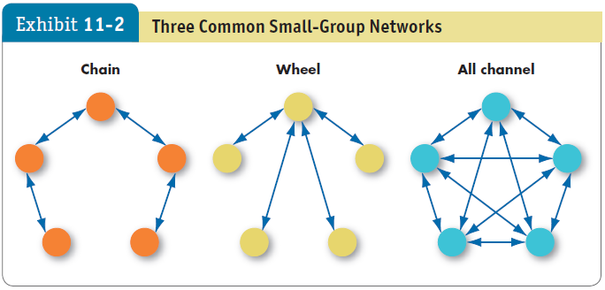
Contrast Downward, Upward, and Lateral Communication
LO 2
Notes:
Formal organizational networks can be complicated, including hundreds of people and a half-dozen or more hierarchical levels. To simplify, we’ve condensed these networks into three common small-group networks of five people each: chain, wheel, and all channel, as shown here in Exhibit 11-2.
The chain rigidly follows the formal chain of command; this network approximates the communication channels you might find in a rigid three-level organization. The wheel relies on a central figure to act as the conduit for all group communication; it simulates the communication network you would find on a team with a strong leader. The all-channel network permits group members to actively communicate with each other; it’s most often characterized in practice by self-managed teams, in which group members are free to contribute and no one person takes on a leadership role.

Slide 15
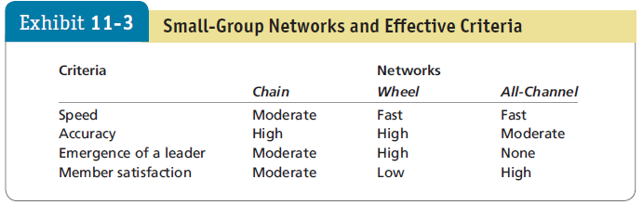
Contrast Downward, Upward, and Lateral Communication
LO 2
Notes:
As Exhibit 11-3 demonstrates, the effectiveness of each network depends on the dependent variable that concerns you. The structure of the wheel facilitates the emergence of a leader, the all-channel network is best if you desire high member satisfaction, and the chain is best if accuracy is most important. This exhibit leads us to the conclusion that no single network will be best for all occasions.

Slide 16


Contrast Downward, Upward, and Lateral Communication
LO 2
The informal communication network in a group or organization is called the grapevine.
It gives managers a feel for the morale of their organization, identifies issues employees consider important, and helps tap into employee anxieties.
Notes:
The informal communication network in a group or organization is called the grapevine. The grapevine is an important part of any group or organization communication network.
It gives managers a feel for the morale of their organization, identifies issues employees consider important, and helps tap into employee anxieties.
The grapevine also serves employees’ needs: small talk creates a sense of closeness and friendship among those who share information, although research suggests it often does so at the expense of those in the “out” group.
There is also evidence that gossip is driven largely by employee social networks that managers can study to learn more about how positive and negative information is flowing through their organization.

Slide 17
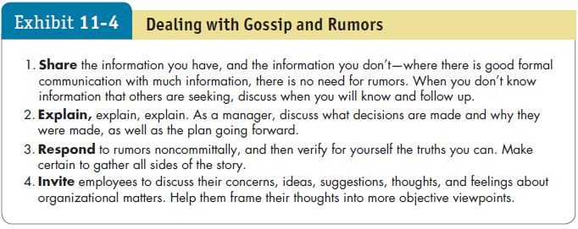
Contrast Downward, Upward, and Lateral Communication
LO 2
Notes:
As shown here in Exhibit 11-4, managers should minimize the negative consequences of rumors by limiting their range and impact.

Slide 18

Contrast Oral, Written, and Nonverbal Communication
LO 3
Oral Communication
The primary means of conveying messages. Speeches, formal one-on-one and group discussions, and informal rumor mills or grapevines are popular forms of oral communication.
Meetings
Videoconferencing and conference calling
Telephone
Notes:
Oral communication is the chief means of conveying messages. Speeches, formal one-on-one and group discussions, and informal rumor mills or grapevines are popular forms of oral communication. Advantages or oral communication are speed and feedback. A major disadvantage arises when the message must be passed through a number of people. This increases the potential for distortion.
Four popular forms of oral communication used in organizations are:
Meetings – can be formal or informal, include two or more people, and take place in almost any venue.
Videoconferencing – permits employees and clients to conduct real-time meetings with people at different locations.
Conference calling – generally limited to telephone exchanges where some people may gather around one speaker phone, and others call in through a secure line.
Telephone – offers many of the benefits of meetings (formal and informal), and can prompt immediate response.

Slide 19





Contrast Oral, Written, and Nonverbal Communication
LO 3
Written Communication
Letters
PowerPoint
E-mail
Instant Messaging
Text Messaging
Social Media
Apps
Blogs
Notes:
Written communications include:
Letters – the oldest and most enduring form of written communication.
PowerPoint – can be an excellent mode of communication because it combines words with visual elements to help engage the reader and explain complex ideas; however, detractors argue that it is too impersonal, disengaging, and frequently misused.
E-mail – has become so pervasive it’s hard to imagine life without it.
Instant Messaging – a synchronous technology, meaning that you need to be there to receive the message.
Text Messaging – usually done via cell phone and often as a real-time alternative to phone calls.
Social Media – has transformed communication. According to research advisory firm Gartner Inc., companies that use social media as more than a marketing tool may lead their industries in growth by 2015.
Blogs (short for web log) – a website about a single person or company. Many organizations and organizational leaders have blogs that speak for the organization.
Others – Flickr, Pinterest, and Google+ are just a few of the many public and industry-specific social platforms.

Slide 20
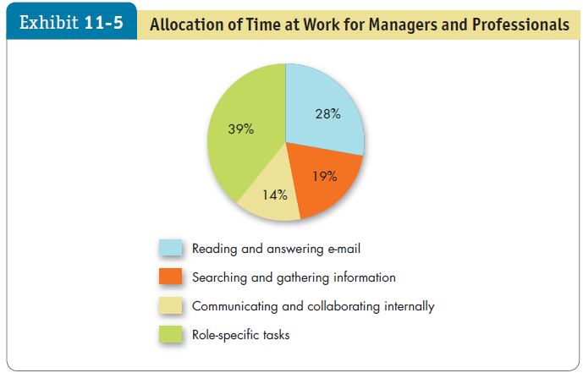

Contrast Oral, Written, and Nonverbal Communication
LO 3
Notes:
Many managers report that they spend too much time on e-mail. Exhibit 11-5 shows that managers spend nearly one-third of their day reading and answering e-mail.

Slide 21
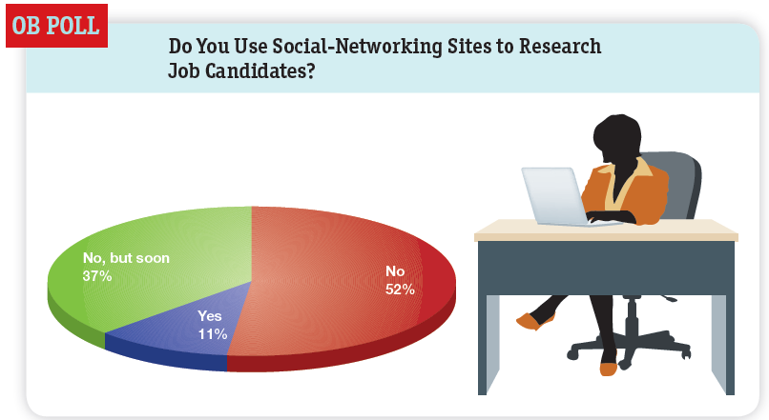

Contrast Oral, Written, and Nonverbal Communication
LO 3
Notes:
Social media has become a tool for prospective employees, hiring managers, and human resource divisions.

Slide 22

Contrast Oral, Written, and Nonverbal Communication
LO 3
Nonverbal Communication
Includes body movements, the intonations or emphasis we give to words, facial expressions, and the physical distance between the sender and receiver.
Body language can convey status, level of engagement, and emotional state.
Notes:
Every time we deliver a verbal message, we also impart a nonverbal message. Sometimes the nonverbal component may stand alone. No discussion of communication would thus be complete without consideration of nonverbal communication, which includes body movements, the intonations or emphasis we give to words, facial expressions, and the physical distance between the sender and receiver.

Slide 23
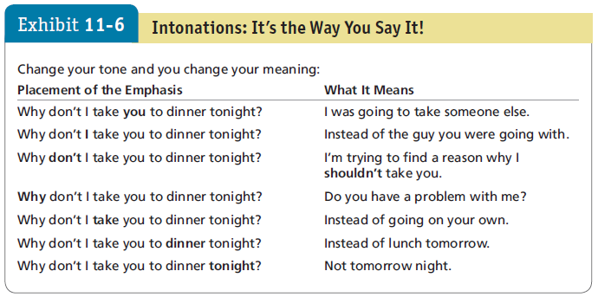
Contrast Oral, Written, and Nonverbal Communication
LO 3
Notes:
If you read the verbatim minutes of a meeting, you wouldn’t grasp the impact of what was said the same way as if you had been there or could see the meeting on video, because there is no record of nonverbal communication. The emphasis given to words or phrases is missing.
Exhibit 11-6 illustrates how intonations can change the meaning of a message.

Slide 24

Contrast Oral, Written, and Nonverbal Communication
LO 3
Physical distance also has meaning.
What is considered proper spacing between people largely depends on cultural norms.
A businesslike distance in some European countries feels intimate in many parts of North America.
Distance may indicate aggressiveness, or it may signal disinterest or displeasure with what is being said.
Notes:
Physical distance also has meaning. What is considered proper spacing between people largely depends on cultural norms. A businesslike distance in some European countries feels intimate in many parts of North America. If someone stands closer to you than is considered appropriate, it may indicate aggressiveness; if farther away, it may signal disinterest or displeasure with what is being said.

Slide 25
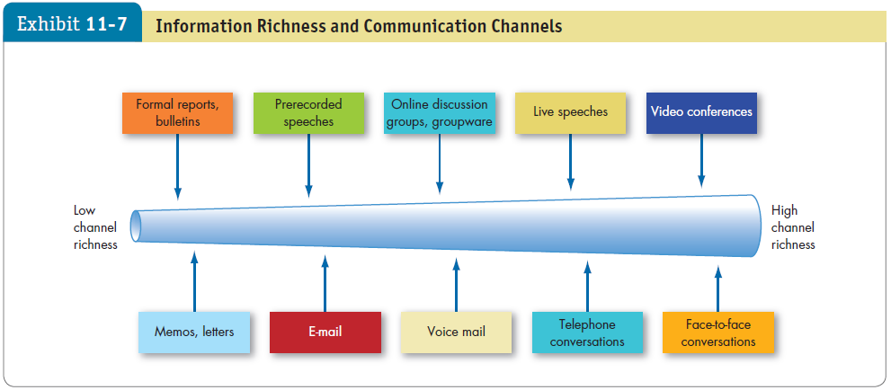




Channel Richness and Choice Of Communication Channel
LO 4
Notes:
Exhibit 11-7 shows that channels differ in their capacity to convey information. Some are rich in that they have the ability to handle multiple cues simultaneously, facilitate rapid feedback, and be very personal. As the exhibit illustrates, face-to-face conversation scores highest in channel richness because it transmits the most information per communication episode, using multiple information cues such as words, postures, facial expressions, gestures, intonations, immediate feedback (both verbal and nonverbal), and the personal touch of being present.
Others are lean in that they score low on these factors. Impersonal written media such as formal reports and bulletins rate lowest in richness.

Slide 26
Channel Richness and Choice Of Communication Channel
LO 4
The choice of channel depends on whether the message is routine.
Routine messages tend to be straightforward and have a minimum of ambiguity.
Choose oral communication when you need to gauge the receiver’s receptivity.
Written communication is more reliable for complex and lengthy communications.
تميل الرسائل غير الروتينية إلى التعقيد وإمكانية سوء الفهم. يمكن توصيل الرسائل الروتينية بكفاءة من خلال القنوات الأقل ثراءً. ومع ذلك ، لا يمكن توصيل الرسائل غير الروتينية بشكل فعال إلا عن طريق اختيار القنوات الغنية
Notes:
The choice of one channel over another depends on whether the message is routine.
Routine messages tend to be straightforward and have a minimum of ambiguity. Nonroutine messages tend to be complicated and have the potential for misunderstanding. Routine messages can efficiently be communicated through channels that are lower in richness. However, nonroutine messages can effectively be communicated only by selecting rich channels.

Slide 27

Channel Richness and Choice Of Communication Channel
LO 4
Know you audience and use good grammar.
Letters
Text messaging
Social media
Blogging
Notes:
Letters are used in business primarily for networking purposes and when signatures need to be authentic.
In general, respond to instant messages only when they are professional, and initiate them only when you know they will be welcome.
There are significant gains and challenges from the introduction of text messaging in business settings. Texts are cheap to send and receive, and the willingness to be available for quick communications from clients and managers is conducive to good business. However, some users view text messaging as intrusive and distracting. Many organizations are also concerned about the security of texting. It is best to severely limit personal text messages during work hours and be cautious about using texting for business purposes.
On the corporate level, the returns on using social media are mixed. If you want to use social media for business purposes as a manager, make certain you are connected with all levels of management engaged in the effort. Use discretion about which social media platforms are acceptable for business communications. Make sure you know your company’s social media policies about corporate confidentiality and your company’s view on your privacy.
As an individual, you may choose to post a blog to your own blog page, or you may choose to comment on another person’s blog. If someone in the company happens to read a critical or negative blog entry or post, there is nothing to keep him or her from sharing that information with others.
It’s important to be alert to nonverbal aspects of communication and look for nonverbal cues as well as the literal meaning of a sender’s words.

Slide 28
Channel Richness and Choice Of Communication Channel
LO 4
Information Security
Electronic information
Physical information
Information that employees know
Most companies monitor employee Internet use and e-mail records, and some use video surveillance and record phone conversations.
Notes:
Security is a huge concern for nearly all organizations with private or proprietary information about clients, customers, and employees. Organizations worry about the security of the electronic information they seek to protect, such as hospital patient data, the physical information they still keep in file cabinets, and the security of the information they entrust their employees with knowing, such as Apple’s need-to-know-only information sharing.
Most companies actively monitor employee Internet use and e-mail records, and some even use video surveillance and record phone conversations. Necessary though they may be, such practices can seem invasive to employees. An organization can relieve employee concerns by engaging them in the creation of information-security policies and giving them some control over how their personal information is used.

Slide 29

Persuasive Communication
LO 5
Automatic processing: a relatively superficial consideration of evidence and information.
It takes little time and low effort, but it lets us be easily fooled by a variety of tricks, like a cute jingle or glamorous photo.
Controlled processing: a detailed consideration of evidence and information relying on facts, figures, and logic.
Requires effort and energy, but it’s harder to fool someone who engages in it.
Notes:
To understand the process of communication, it is useful to consider two relatively different ways that we process information. First, we’ll discuss automatic processing.
We often rely on automatic processing, a relatively superficial consideration of evidence and information making use of heuristics like those we discussed in Chapter 6. Automatic processing takes little time and low effort, so it makes sense to use it for processing persuasive messages related to topics you don’t care much about. The disadvantage is that it lets us be easily fooled by a variety of tricks, like a cute jingle or glamorous photo.
So what is controlled processing? Suppose you’re looking for a place to live. You do independent research among experts who know something about the subject, gather information about prices from a variety of sources, and consider the costs and benefits of renting versus buying. This is called controlled processing: a detailed consideration of evidence and information relying on facts, figures, and logic. Controlled processing requires effort and energy, but it’s harder to fool someone who has taken the time and effort to engage in it.

Slide 30



Persuasive Communication
LO 5
Rules of thumb for determining the choice of processing:
Interest level
Prior knowledge
Personality
Message characteristics
Match your message to your audience
Notes:
There are a few rules of thumb for determining what types of processing an audience will use.
One of the best predictors of whether people will use an automatic or controlled process for reacting to a persuasive message is their level of interest in it. When people are very interested in the outcome of a decision, they’re more likely to process information carefully.
People who are very well informed about a subject area are also more likely to use controlled processing strategies. On the other hand, people who are poorly informed about a topic can change their minds more readily, even in the face of fairly superficial arguments presented without a great deal of evidence.
People who require many facts before making a decision have a high need for cognition, a personality trait of individuals who are most likely to be persuaded by evidence and facts.
Another factor that influences whether people use an automatic or controlled processing strategy is the characteristics of the message itself. Messages provided through relatively lean communication channels, with little opportunity for users to interact with the content of the message, tend to encourage automatic processing. Conversely, messages provided through richer communication channels, like a long magazine article, tend to encourage more deliberative processing.
The most important implication of all this research is to match your persuasive message to the type of processing your audience is likely to use. For example, when the audience is not especially interested in a persuasive message topic, when they are poorly informed, when they are low in need for cognition, and when information is transmitted through relatively lean channels, they’ll be more likely to use automatic processing. In these cases, use messages that are more emotion-laden and associate positive images with your preferred outcome. On the other hand, when the audience is interested in a topic, when they are high in need for cognition, or when the information is transmitted through rich channels, then it is a better idea to focus on rational arguments and evidence to make your case.

Slide 31

Identify Common Barriers to Effective Communication
LO 6
Barriers to Effective Communication
Filtering
Selective perception
Information overload
Emotions
Language
Silence
Communication apprehension
Lying
manipulating information so it will be seen as more favorable by the receiver
describes how receivers selectively see and hear based on their needs, motivations, experience, background, and other personal characteristics
Notes:
There are many barriers to effective communication.
Filtering refers to a sender’s purposely manipulating information so it will be seen as more favorable by the receiver. For example, telling the boss what she wants to hear. The more levels in an organization’s structure, the more opportunities there are for filtering.
Selective perception describes how receivers selectively see and hear based on their needs, motivations, experience, background, and other personal characteristics. Receivers project their interests and expectations into communications as they decode them.
Information overload occurs when the information we have to work with exceeds our processing capacity. The result is the tendency to select out, ignore, pass over, or forget information. Or put it aside until the overload situation is over. The result is lost information and less effective communication.
Emotions also influence how people receive messages. People in negative moods are more likely to scrutinize messages in greater detail, whereas those in positive moods tend to accept communications at face value. Extreme emotions such as jubilation or depression are most likely to hinder effective communication.
Message senders tend to incorrectly assume the words and terms they use mean the same to the receiver as to them, but even when we’re communicating in the same language, words mean different things to different people. Age and context are two of the biggest factors that influence such differences.
It’s easy to ignore silence or lack of communication because it is defined by the absence of information. However, research suggests using silence and withholding communication are common and problematic. Silence is less likely where minority opinions are treated with respect, work-group identification is high, and high procedural justice prevails.
An estimated 5 to 20% of the population suffers from communication apprehension. They experience undue tension or anxiety in oral and/or written communication. They may find it difficult to talk with others face-to-face or on the telephone. Studies show those who are oral-communication apprehensive avoid situations for which oral communication is a dominant requirement. Managers should be aware of the impact of communication apprehension on job performance.
The final barrier to effective communication is outright misrepresentation of information, or lying. The problem is, there are no nonverbal or verbal cues unique to lying—averting your gaze, pausing, and shifting your posture can also be signals of nervousness, shyness, or doubt. In sum, the frequency of lying and the difficulty in detecting liars makes this an especially strong barrier to effective communication in organizations.

Slide 32

Overcoming Problems in Cross-Cultural Communication
LO 7
Cultural Barriers
Caused by semantics – words mean different things to different people.
Caused by word connotations – words imply different things in different languages.
Caused by tone differences.
Caused by differences in tolerance for conflict and methods for resolving conflicts.
In some cultures, language is formal; in others, it is informal. The tone changes depending on the context.
Notes:
Cross-cultural barriers increases the potential for communications problems.
First, there are barriers caused by semantics: words mean different things to different people. Some words do not translate between cultures. For example, English terms such as efficiency, free market, and regulation are not directly translatable into Russian.
Second, there are barriers caused by word connotations: words imply different things in different languages. For example, the Japanese word ok. means “yes,” but may mean “yes, I’m listening,” not “yes, I agree.”
Third, there are barriers caused by tone differences. In some cultures, language is formal; in others, it is informal. The tone changes depending on the context.
Fourth, there are cultural differences in tolerance for conflict and methods for resolving conflicts. Individuals from individualist cultures tend to be more comfortable with direct conflicts and will make the source of their disagreements overt. Collectivists are more likely to acknowledge conflict only implicitly and avoid emotionally charged disputes. They may attribute conflicts to the situation more than to the individuals and therefore may not require explicit apologies to repair relationships, whereas individualists prefer explicit statements accepting responsibility for conflicts and public apologies to restore relationships.

Slide 33
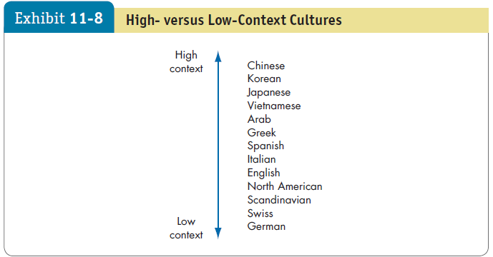
Overcoming Problems in Cross-Cultural Communication
LO 7
Notes:
Cultures tend to differ in the importance to which context influences meaning, which is illustrated here in Exhibit 11-8.
Countries like China, Korea, Japan, and Vietnam, are high-context cultures. They rely heavily on nonverbal and subtle situational cues when communicating with others. What is not said may be more significant than what is said. A person’s official status, place in society, and reputation carry considerable weight and public apologies to restore relationships.
People from Europe and North America reflect their low-context cultures. They rely essentially on words to convey meaning. Body language or formal titles are secondary to spoken and written words.

Slide 34



Overcoming Problems in Cross-Cultural Communication
LO 7
A Cultural Guide
Know yourself.
Foster a climate of mutual respect, fairness, and democracy.
State facts, not your interpretation.
Consider the other person’s viewpoint.
Proactively maintain the identity of the group.
Notes:
When communicating with people from a different culture, what can you do to reduce misinterpretations? Fred Casmir, a leading expert in intercultural communication research, and other experts offer the following suggestions:
Know yourself.
Foster a climate of mutual respect, fairness, and democracy.
State facts, not your interpretation.
Consider the other person’s viewpoint.
Proactively maintain the identity of the group.

Slide 35
Implications for Managers
Remember that your communication mode will partly determine your communication effectiveness.
Obtain feedback from your employees to make certain your messages—however they are communicated—are understood.
Remember that written communication creates more misunderstandings than oral communication; communicate with employees through in-person meetings when possible.
Notes:
You’ve probably discovered the link between communication and employee satisfaction in this chapter: the less uncertainty, the greater the satisfaction. Distortions, ambiguities, and incongruities between verbal and nonverbal messages all increase uncertainty and reduce satisfaction.
Specific implications for managers are:
Remember that your communication mode will partly determine your communication effectiveness.
Obtain feedback from your employees to make certain your messages—however they are communicated—are understood.
Remember that written communication creates more misunderstandings than oral communication; communicate with employees through in-person meetings when possible.

Slide 36
Implications for Managers
Make sure you use communication strategies appropriate to your audience and the type of message you’re sending.
Keep in mind communication barriers such as gender and culture.
Notes:
Finally, managers should:
Make sure you use communication strategies appropriate to your audience and the type of message you’re sending.
Keep in mind communication barriers such as gender and culture.

